Slide 1





Building open big data via community curated data resources: Neotoma and PalEON
John (Jack) Williams, UW-Madison
and many others
I: Building Big Data
II: PalEON: Building a Deeper Baseline for Better Ecological Prediction
III: Neotoma Paleoecology Database: Recent Advances
Neotoma DB
Macrosystems, Geoinformatics,
EarthCube
@IceAgeEcologist @neotomadb
@Pal_EON
@EarthRates
C4P
Notes:
Thank you.
Acknowedge collaborators.
Talk in two parts.
First, talk about building community data networks in paleoecology – as example of larger class of activities that I call community curated database
Second, show the kind of large-scale synthetic science that is enabled with open high-quality data platforms, using PalEON as an example.

Slide 2
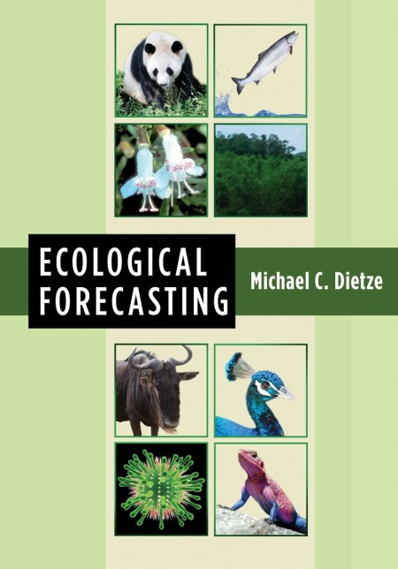
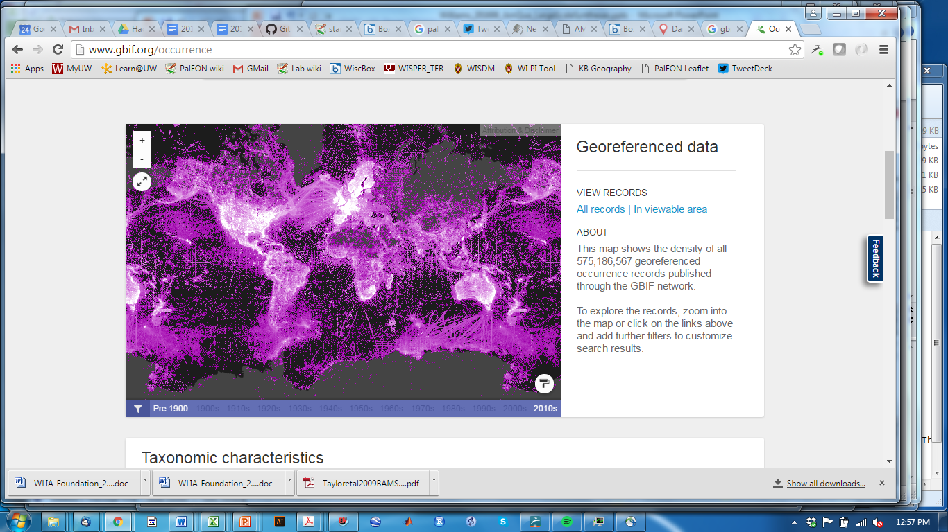
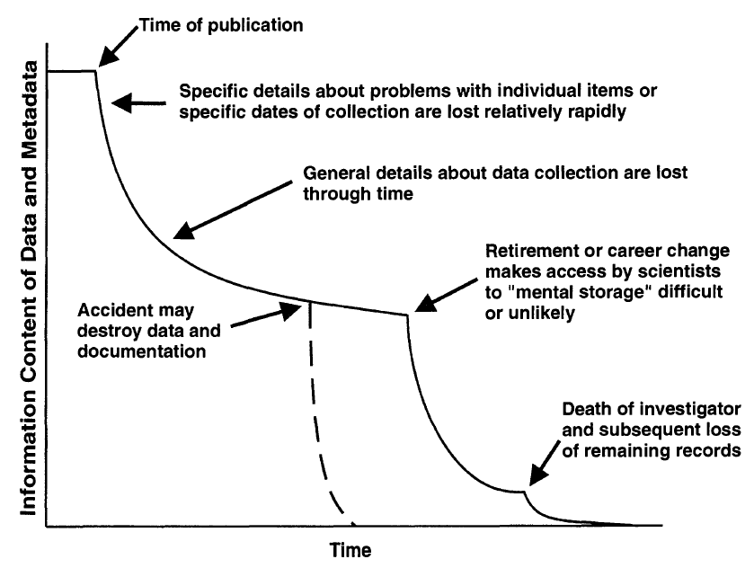

Motivation
Better Ecological Forecasting
Species dynamics during geological-scale changes
Burke et al. in prep.
Earth System Informatics: Building big data
Reducing Data Entropy
Michener et al. 1997

Slide 3


Building Open Community-Curated Data Resources
Data Generators
Data Synthesizers
Primary Data,
Expertise
DOIs,
Preservation,
Cleaning,
Citation
Data Discovery,
Data Access,
Data Cleaning
Data mobilization
Error detection, correction
Refined age models
Data standardization
Data linking
Data Stewards
Open Community
Data Resources
Williams et al. 2018 PAGES

Slide 4

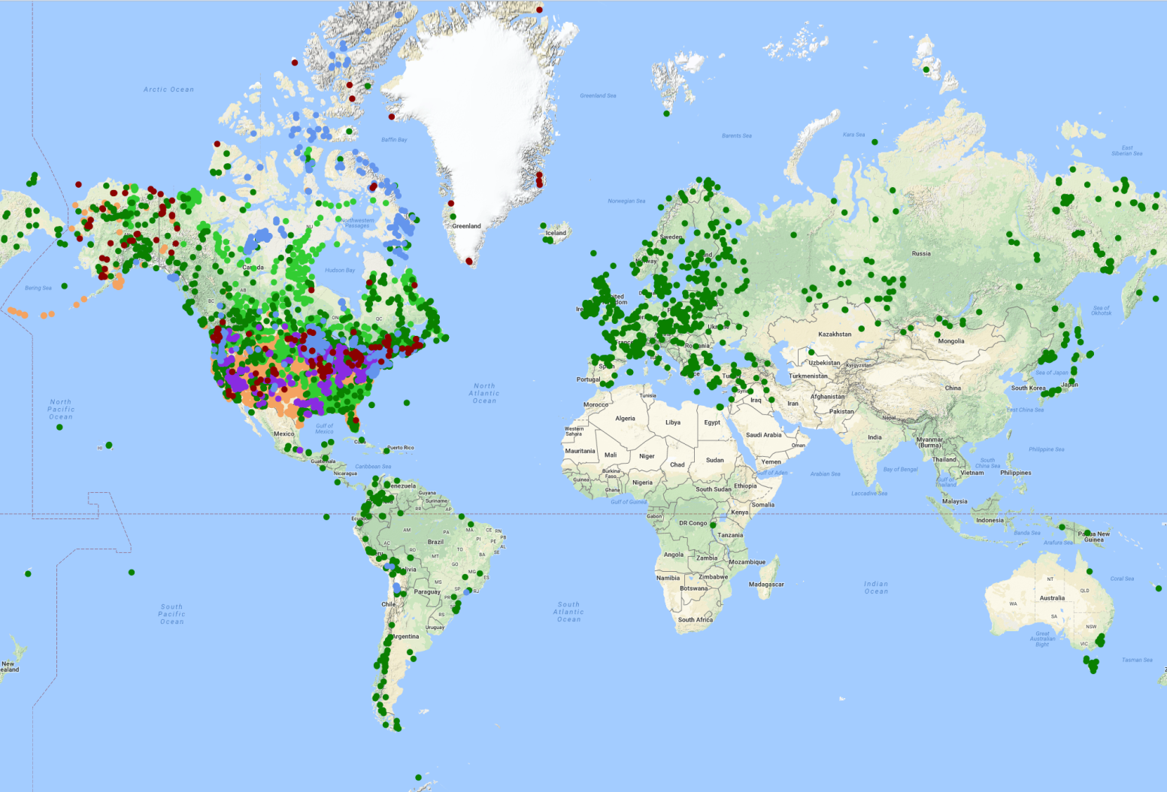
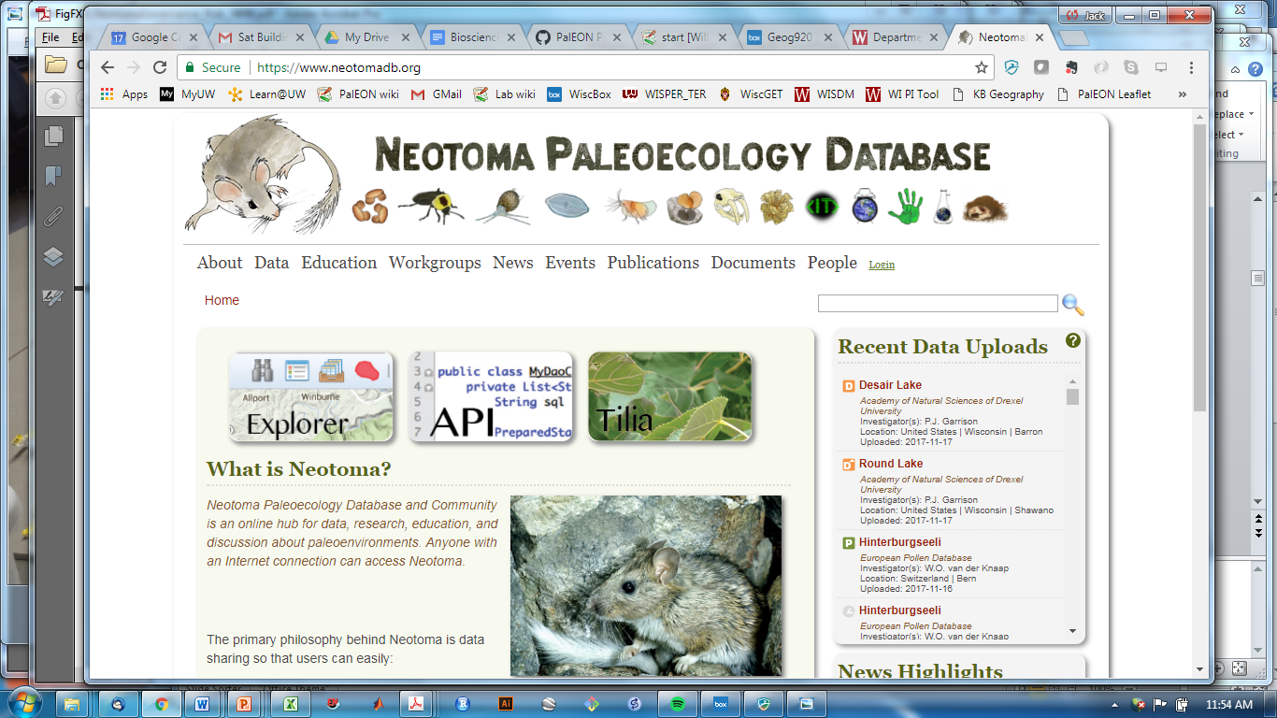


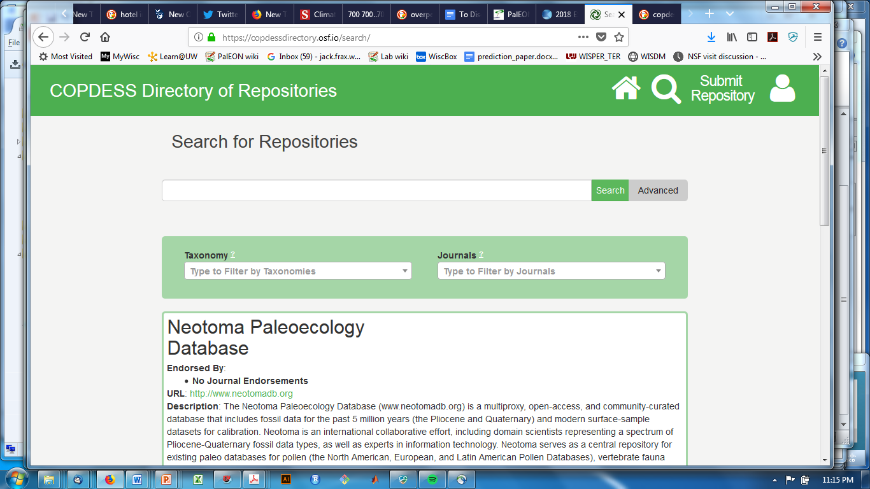

Neotoma Paleoecology Database
Neotoma DB
Mission: Support global-change research by providing an open, community-curated repository for multiple kinds of paleoecological data
Key Characteristics
Open Data
Curated by Community -> High-Value Data
Standardized Variable Names & Taxonomy
Flexible data models for sites, proxies, cores, etc.
Time: Age Controls and Age Models
>4 million observations
>31,400 datasets
>15,200 sites
(Aug 5, 2018)
www.neotomadb.org
Williams, Grimm et al. 2018Quaternary Research

Slide 5
‘I’d like to give a shoutout to open-access databases. These databases are what we early career scientists need to get jobs.’
-Vachel Carter, AmQua, 2018
See also Koch et al. 2018 PAGES Magazine

Slide 6
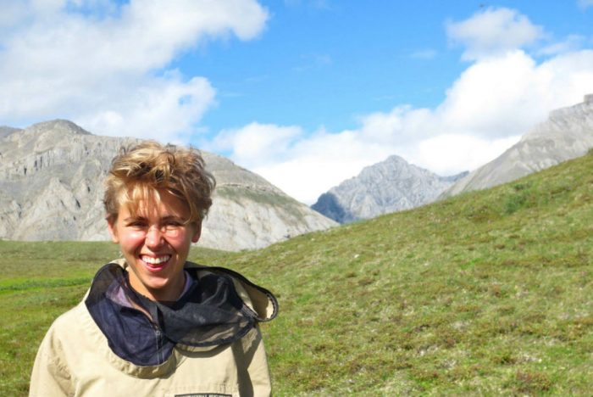
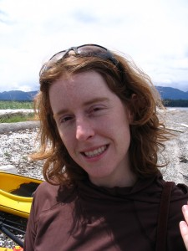
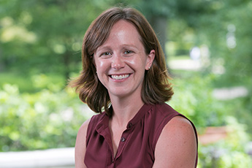

Part II: Building a Deeper Baseline for Ecological Forecasting
Jason McLachlan, Charlie Cogbill, Andria Dawson, Michael Dietze, Istam Fer, Andrew Finley, Simon Goring, Amy Hessl, Phil Higuera, Mevin Hooten, Jenn Marlon, David Mladenoff, Dave Moore, Chris Paciorek, Neil Pederson, Jody Peters, Steve Jackson, Christy Rollinson, Jun Zhu, et al.
Ann Raiho
Andria
Dawson
Christy
Rollinson
Simon Goring
Macrosystems
Notes:
Thank you.
Acknowedge collaborators.
Talk in two parts.
First, talk about building community data networks in paleoecology – as example of larger class of activities that I call community curated database
Second, show the kind of large-scale synthetic science that is enabled with open high-quality data platforms, using PalEON as an example.

Slide 7
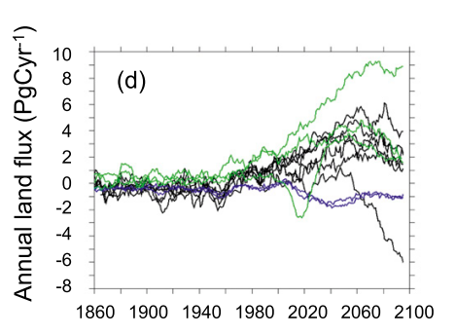
Motivation: Improved Ecological Prediction
Will the terrestrial biosphere be a net carbon source or sink?
Past
Future
Year
Friedlingstein et al. 2014 J. Climate

Slide 8
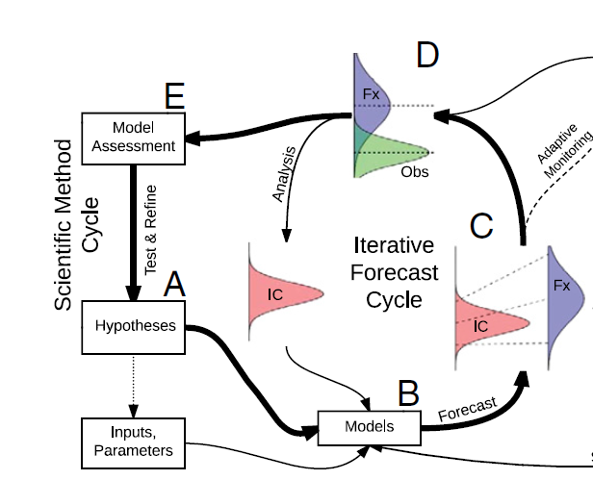
Better data -> better ecological forecasting
DATA
MODELS
Requires tight, iterative loops between models and data
High-volume, high-veracity data -> better model constraints
High-velocity data -> faster learning
Dietze et al. 2018 PNAS, Dietze 2017

Slide 9
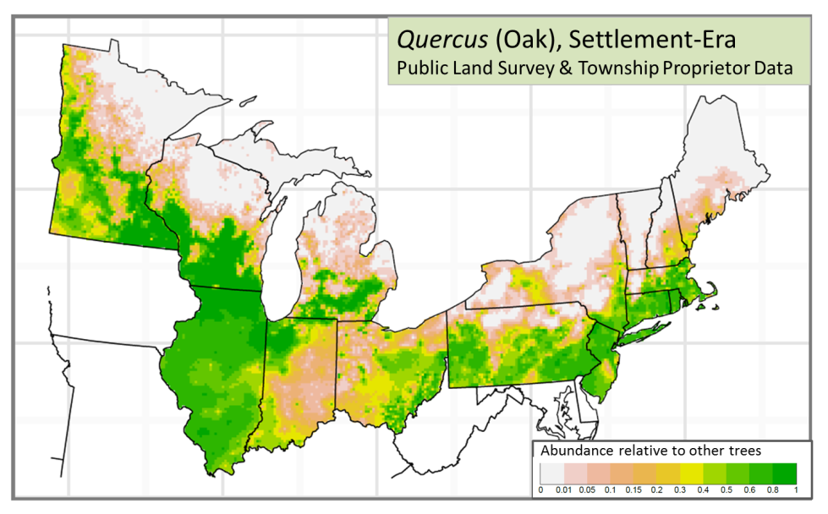
PalEON: The Paleoecological Observatory Network
Who: 14 PIs, 8 institutions, 50+ participants
Where & When: NEUS & Alaska, Last 2000 years to 20th Century
Why: Improve the predictive capacity of terrestrial ecosystem forecasting models
How: Build a deeper baseline: Study the transient and non-stationary trajectory of ecosystems starting ~2000 years ago and continuing through the 21st century
Paleodata Specialists
Ecosystem Modelers
Ecological Statisticians
NSF-Macrosystems
Notes:
PIs: McLachlan, Finley, Pederson, Williams, Zhu, Moore, Hooten, Dietze, Jackson, Paciorek, Marlon, Higuera, Duffy, Hessl
Institutions: Arizona, Wisconsin, Notre Dame, Michigan State,

Slide 10
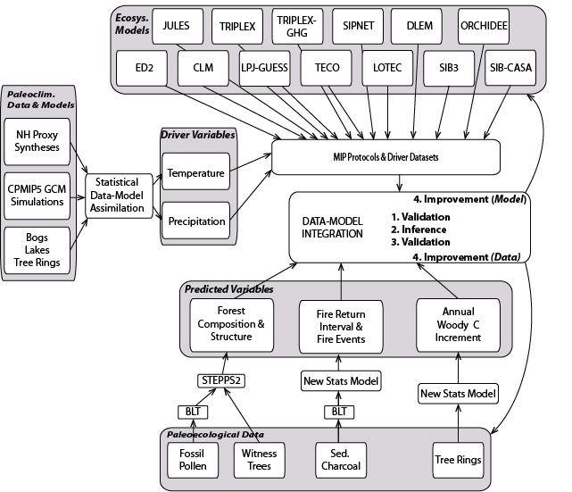
PalEON: Major Components
1
Model Intercomparison Project (MIP) with ~10 Ecosystem Models, CMIP5 AR5 climate simulations for last 1,200 yrs
Tree Rings: reconstructions of tree growth & NPP over past several centuries
Sedimentary Charcoal: Fire and disturbance history
SetVeg: reconstructions of forest composition and biomass for settlement era and last 2,000 years
Data-Model Assimilation: Underway
5
4
3
2
NSF-Macrosystems

Slide 11
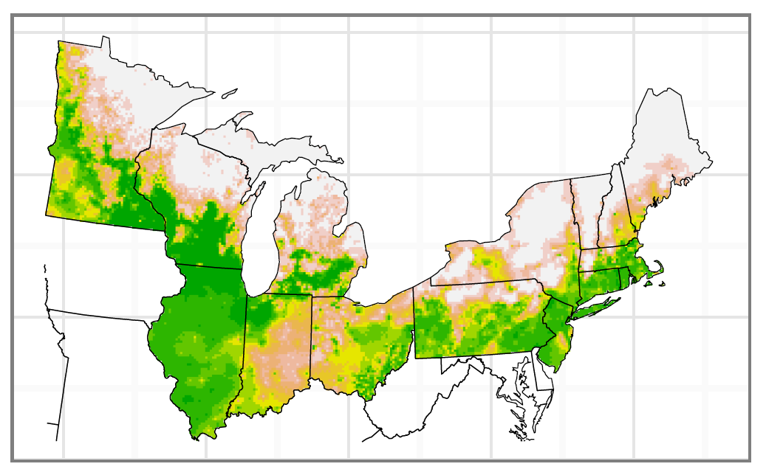
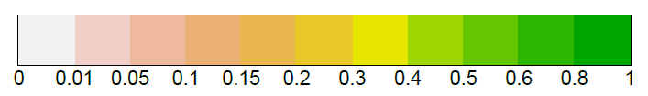
New datasets of pre-Euro-settlement datasets of forest composition and structure
Quercus (Oak), ca.1620-1890 AD, 8km grid
Public Land Survey & Township Proprietor Data
Abundance relative to other trees
860,000 trees in UMW
420,000 trees in NEUS
Paciorek et al. 2016., PLoS One
Goring et al. 2016, PLoS One
https://portal.lternet.edu/nis/mapbrowse?packageid=msb-paleon.1.0
https://portal.lternet.edu/nis/mapbrowse?packageid=msb-paleon.2.0

Slide 12
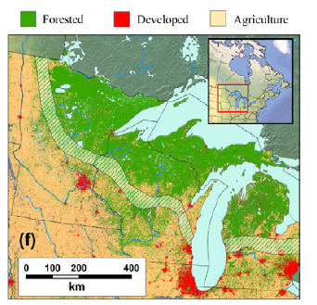
Shifts in tree-climate relationships over past 150 years
T_{max} (ºC)
T_{max} (ºC)
(PLS, PRISM 1895-1919)
(FIA, PRISM 1990-2014)
P_{ann}(mm)
Trees in upper Midwest now occupy warmer winters and higher precipitation than during settlement era
Goring & Williams 2017, Ecology Letters
Notes:
Taylor plot

Slide 13
Attribution: Niche shifts for minimum temperature mainly caused by climate change
Climate Change Dominates
50
Climate Effect – Land Use Effect
0
Vegetation Change Dominates
-50
40
80
120
160
Total Niche Shift: Modern vs. Settlement-Era
Implies growing disequilibrium, climate changes faster than tree distribution shifts
Goring & Williams 2017, Ecology Letters

Slide 14


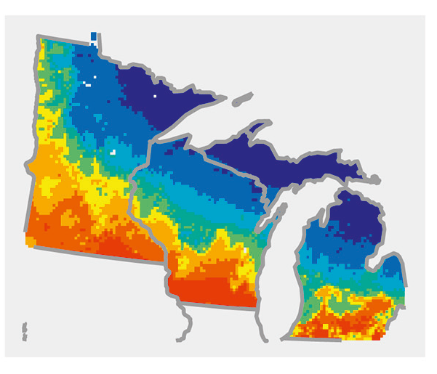
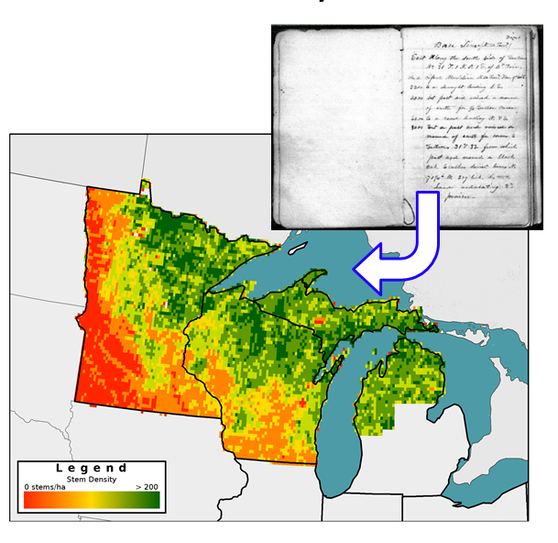
Reconstructing Vegetation for last 2000 yrs: Neotoma – PalEON integrated workflow
Data cleaning,
standardization,
upload
Individual Data Contributors
Hotchkiss, Calcote, & Lynch
Hupy & Yansa
Booth & Jackson
Cushing
St. Jacques
Neotoma DB
R
neotoma
Rebuild age
models (bacon)
STEPPS
Pollen
Paleoveg.
Witness Tree
Data
Reconstrux
w/ uncertainty
Vegetation
Goring et al. (2015) Open Quaternary
Goring et al. (2016) PLoS
Dawson et al. (2016) QSR, Dawson et al. in prep.

Slide 15
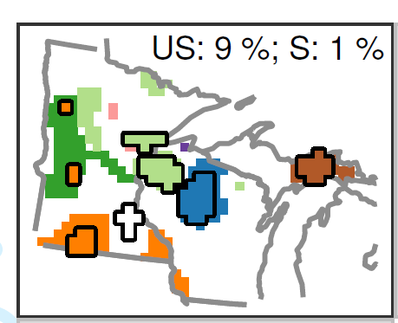
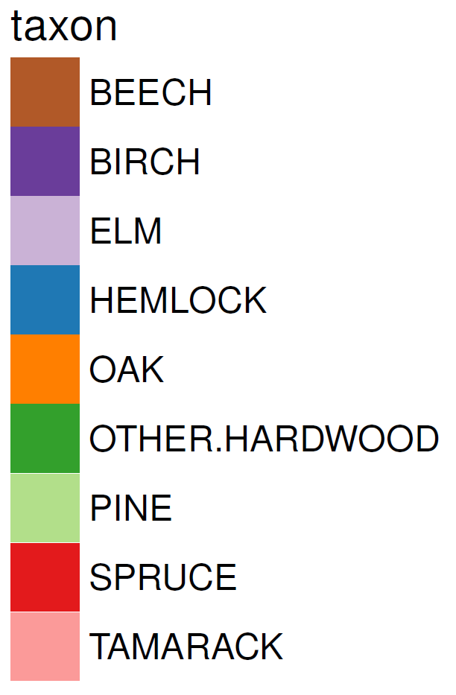
A non-stationary baseline: areas of significant forest change over last 2,000 years
Areas of Significant Forest Change: 2100 to 300 yr BP
Dawson et al. in review Ecology

Slide 16
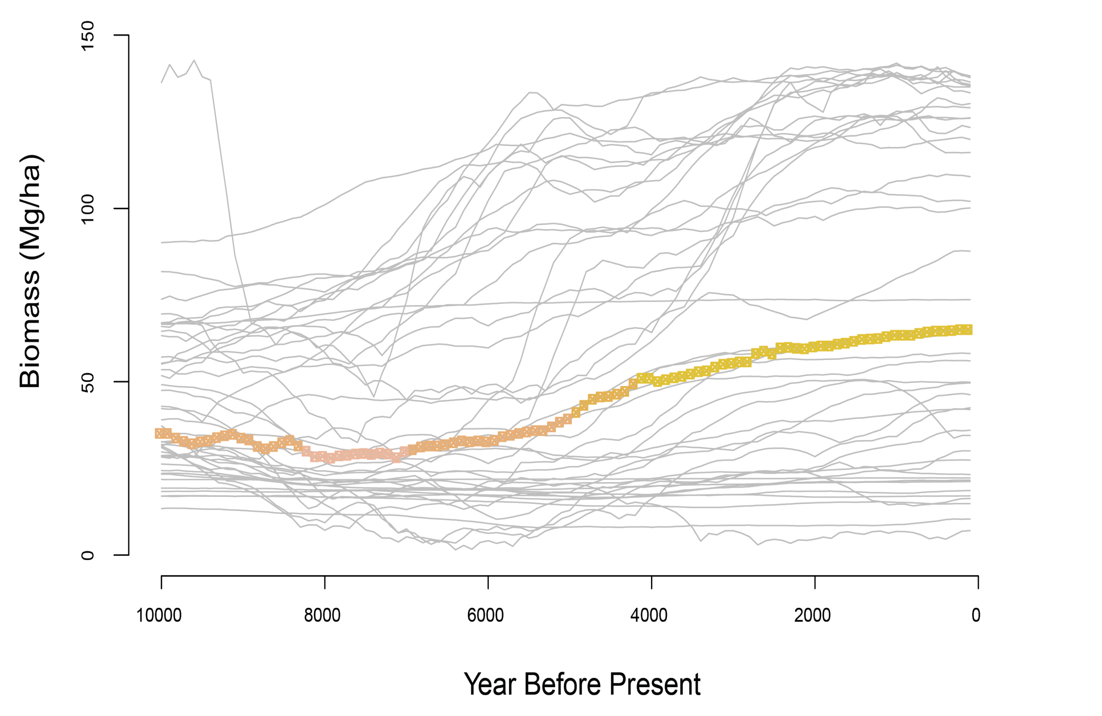
Holocene trends in above-ground biomass in upper Midwest
Increasing biomass for last 6000 years
No pre-Industrial steady state
A. Raiho et al. in prep.

Slide 17
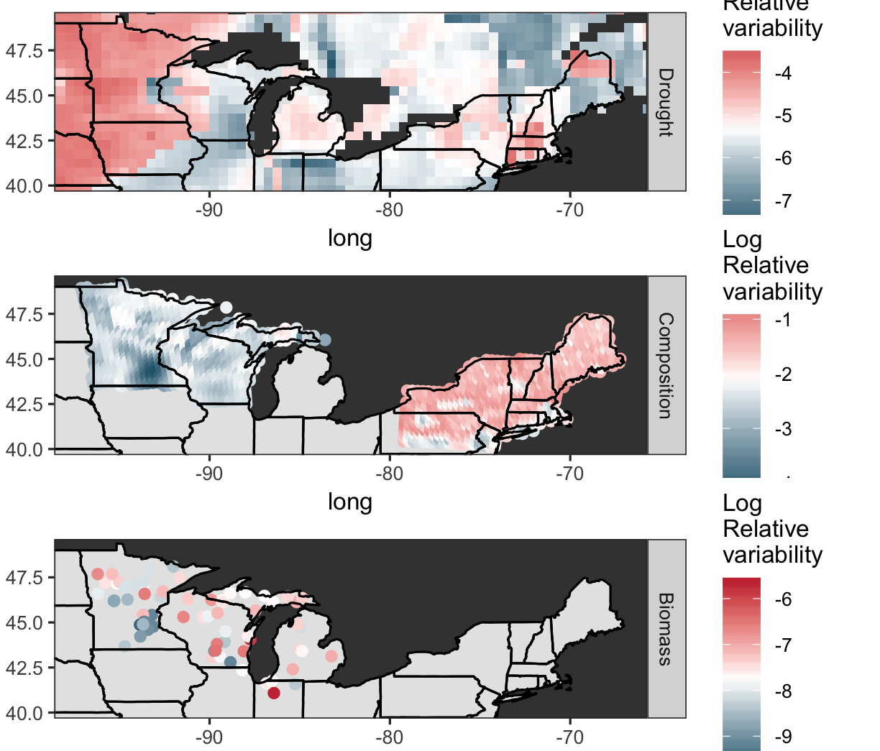
Data Model Comparisons: Ecosystem Sensitivity to Drought Variability
Hydroclimate Variability (Tree Rings)
Compositional Variability (Pollen)
Biomass Variability (Pollen)
C. Rollinson et al. in prep.

Slide 18
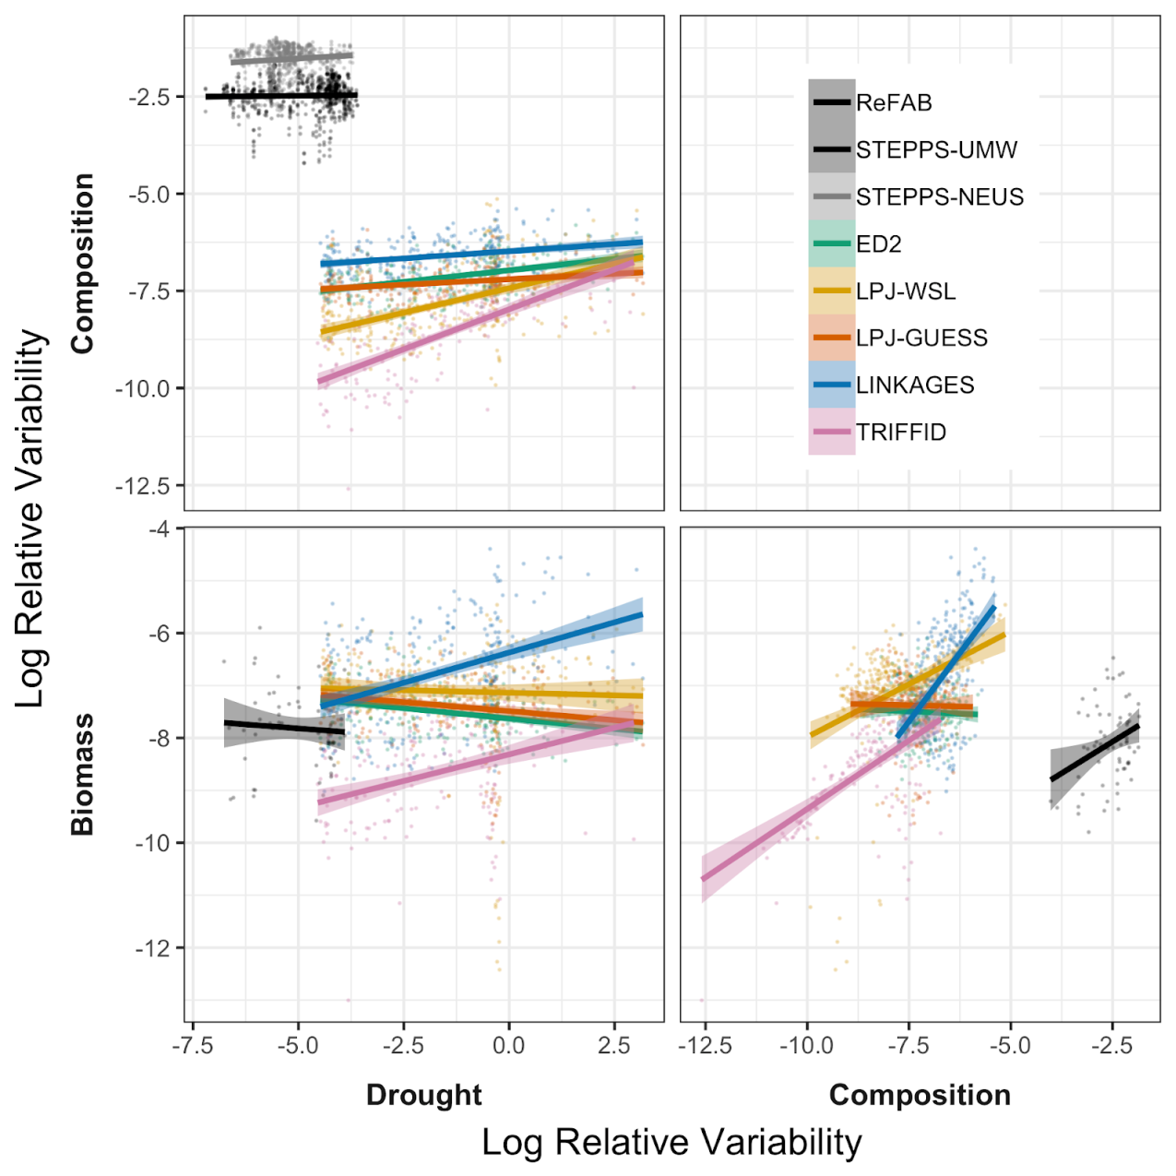
Models: More sensitive to drought than observations
Data
Why? Data:
Sensitive to biodiversity, ecotonal position
Models:
Simpler models (fewer PFTs, simpler ecophysiology) tend to be too sensitive
Models
Rollinson et al. in prep

Slide 19
Summary: Three Lessons Learned
Tree-climate relationships already changing.
Attributable to changing climates (ecological disequilibrium) and land use, disease
Projections of tree range shifts based on modern (FIA) data only may be inaccurate

Slide 20
Summary: Three Lessons Learned
Forests not in steady state prior to European Settlement
Statistical significance established
Increasing forest biomass over last 6,000 years
Ecosystem models tend to be overly sensitive to drought variability relative to data
Models: Higher complexity -> lowered sensitivity
Data: climate vulnerability outweighs climate exposure

Slide 21
Part III: Building Big Data from the Long Tail: Community Curated Data Resources & the Neotoma Paleoecology Database
Eric C. Grimm, Jack Williams, Jessica Blois, Simon Goring, Alison Smith, Joaquin Arroyo-Cabrales, Allan Ashworth, Julio Betancourt, Jessica Blois, Bob Booth, Phil Buckland, Don Charles, Steve Crawford, Brandon Curry, Ed Davis, Thomas Giesecke, Russ Graham, Steve Jackson, Rob Roth, Mike Stryker, et al.
Neotoma DB
Geoinformatics,
EarthCube
@IceAgeEcologist @neotomadb
@Pal_EON
@EarthRates
Notes:
Thank you.
Acknowedge collaborators.
Talk in two parts.
First, talk about building community data networks in paleoecology – as example of larger class of activities that I call community curated database
Second, show the kind of large-scale synthetic science that is enabled with open high-quality data platforms, using PalEON as an example.

Slide 22
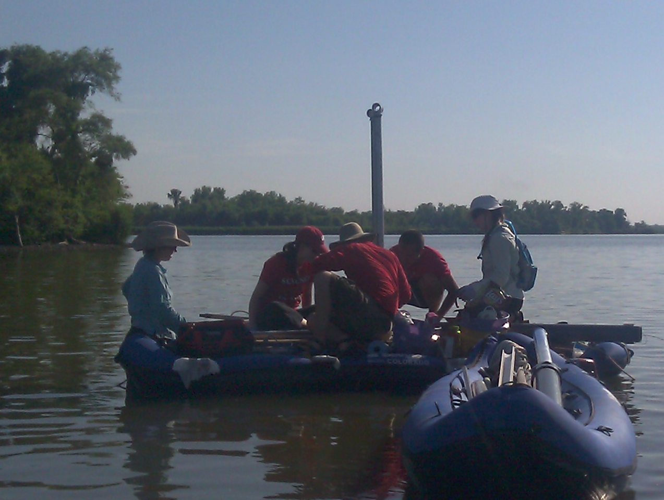
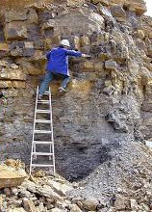
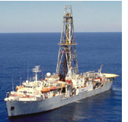
Paleoecological data: Key characteristics
‘Long Tail’: Collected in the field & lab by many individuals and scientific teams.
Heterogeneity: Many kinds of measurements & methods
Distributed Scientific Expertise by proxy type, archive type, region, time period, and/or taxonomic group
Commonality: All involve measurements of proxies in various geological archives by depth, from which we estimate time.
Long Shelf Life: specimens & samples collected decades ago are can be re-analyzed
Bad News
Good News

Slide 23
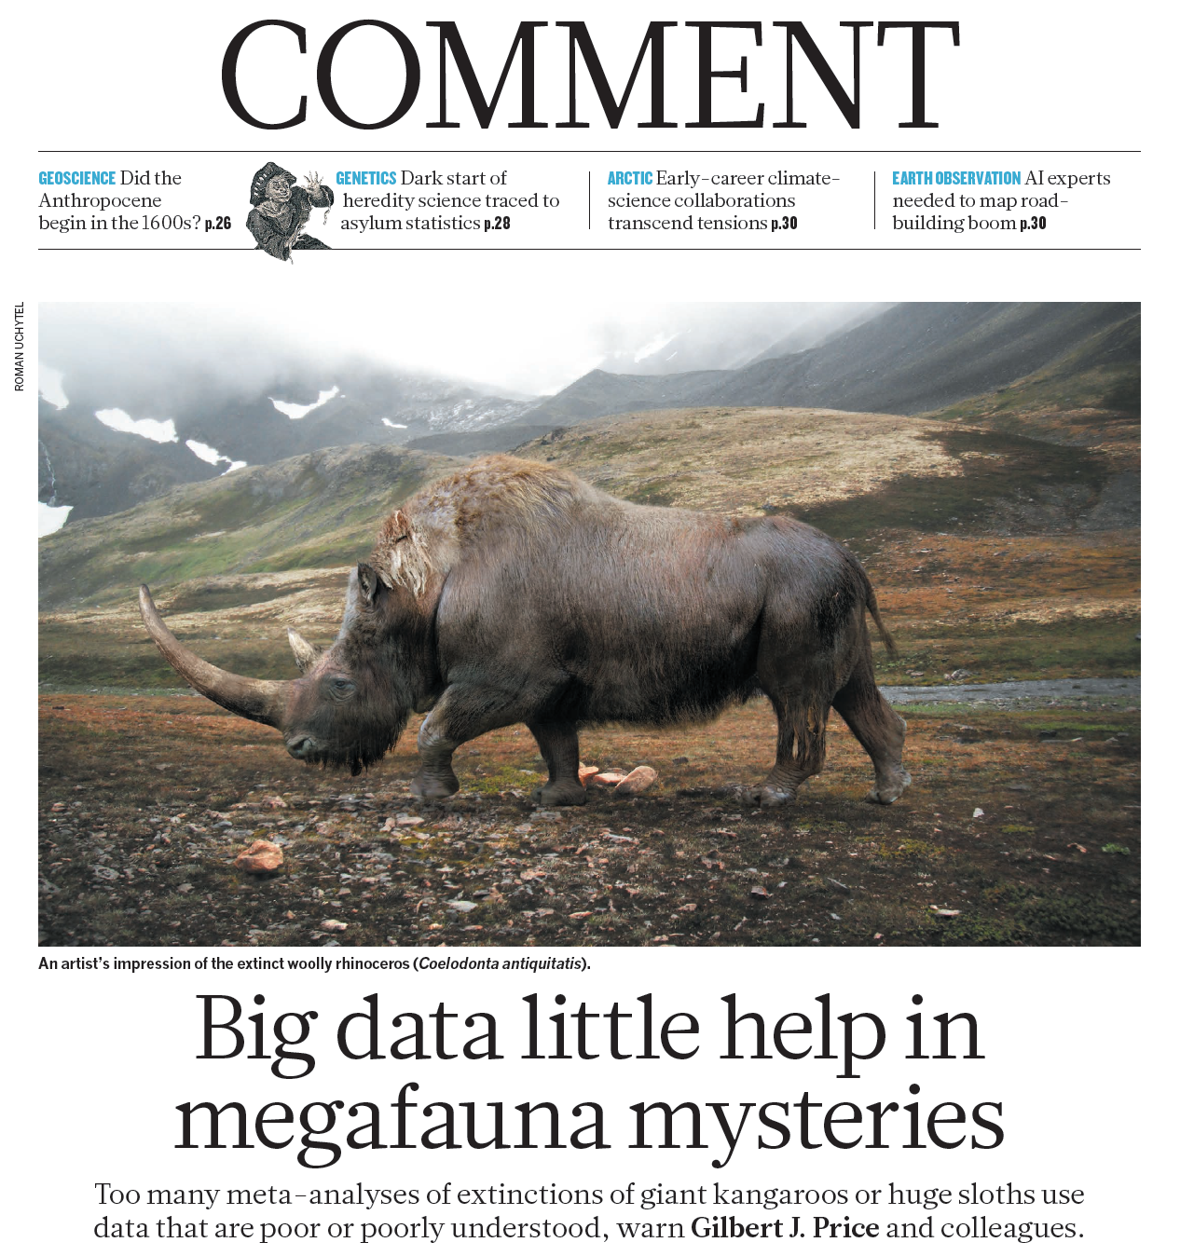
The Big Data Challenge:
How do we jointly maximize data volume and data quality?
Price et al. 2018 Nature

Slide 24



Community-Curated Data Resources (CCDRs)
Socio-Technological Characteristics
Shared Mission: gathering, improving, and sharing data
Centered on Communities of Practice
Distributed community governance to encourage data additions, ensure data quality
Centralized IT platform for collecting, refining, and sharing data
Open Data via multiple outlets
Streamlined data uploads for data and metadata
Meso-scale: bridge between long tail and big data
Social
Paleobiology DB
Technological
Neotoma DB
… and others
...
Notes:
Socio-technological

Slide 25
Neotoma Paleoecology Database: An Open, Community-Curated, Scientific Data Resource
>4 million observations
>31,400 datasets
>15,200 sites
(Aug 5, 2018)
www.neotomadb.org
Williams, Grimm et al. 2018 Quaternary Research
Neotoma DB

Slide 26
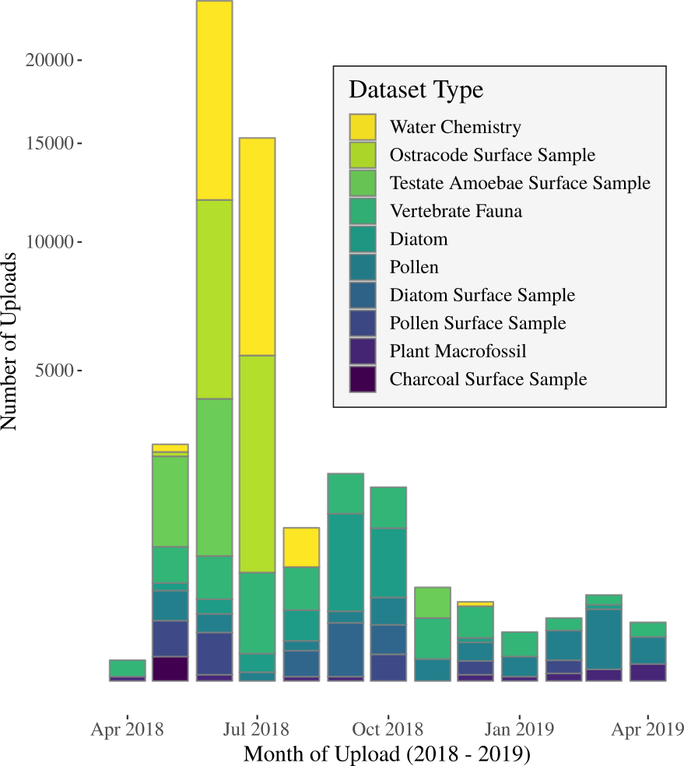
Data Uploads
Last 12 Months
1700+ datasets, by 500+ PIs from 600+ publications uploaded in the last 6 months
4400 ostracode and 4500 water chemistry datasets uploaded in 2018
New Constituent Databases including Stable Isotopes in Zooarchaeology, Neotoma Biomarker Database, and Alpine Pollen Database
All datasets have DOIs and landing pages minted following QA/QC

Slide 27
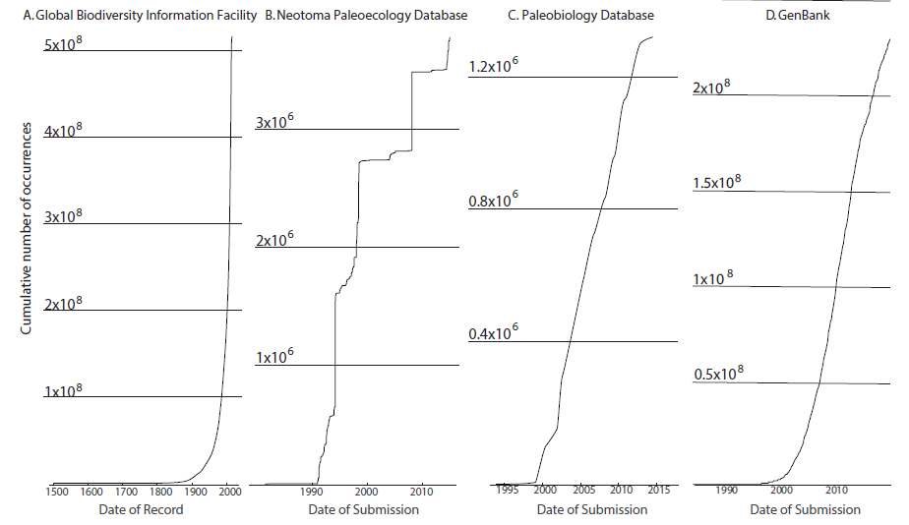
Rapid Growth in Data Volumes

Slide 28
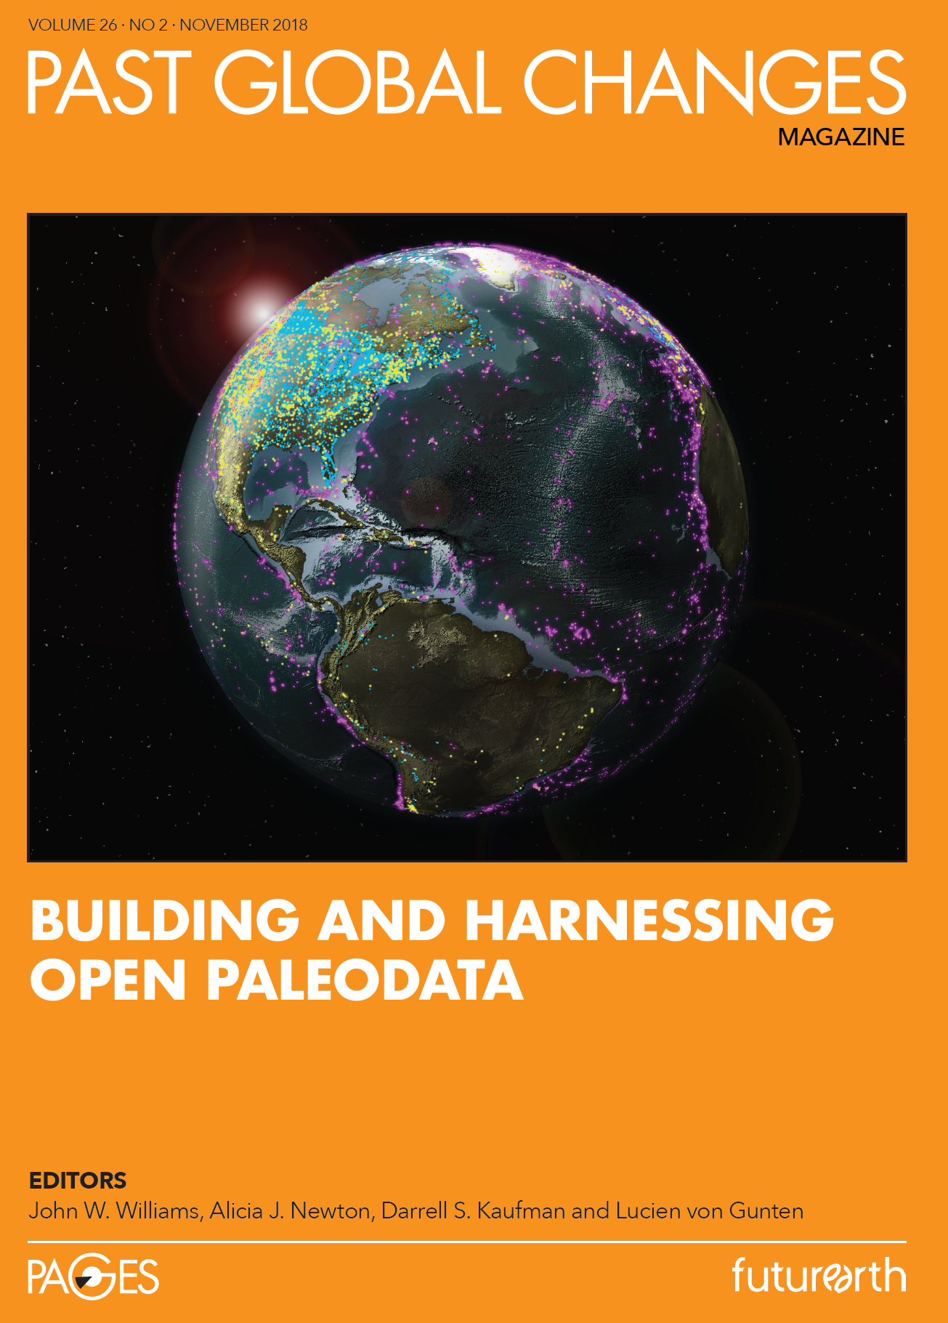
Special Issue of PAGES Magazine

Slide 29
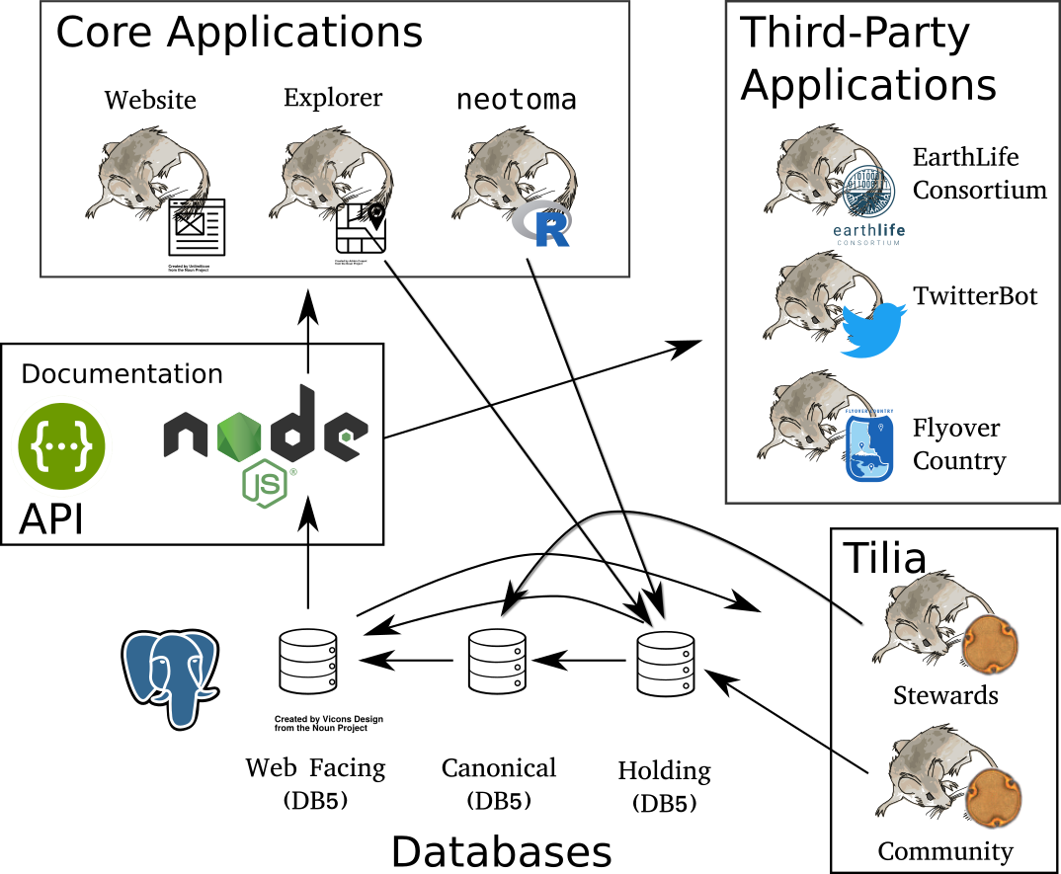
Neotoma Software Ecosystem
Williams, Grimm et al. 2018
Quaternary Research

Slide 30
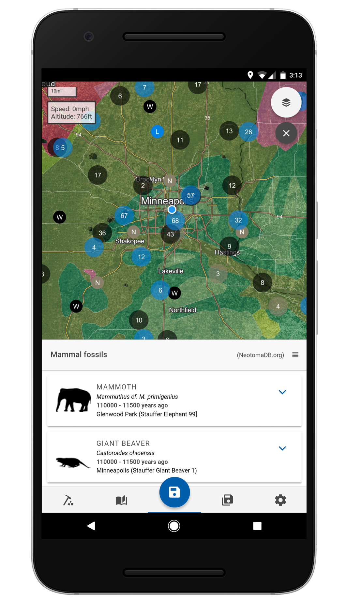
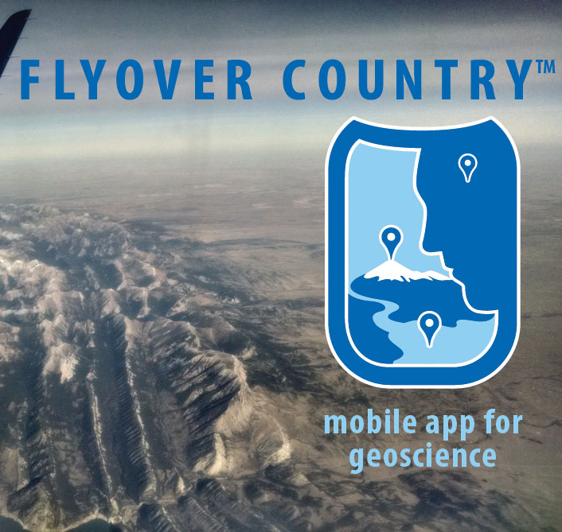
Flyover Country: Making Data Open to All

Slide 31
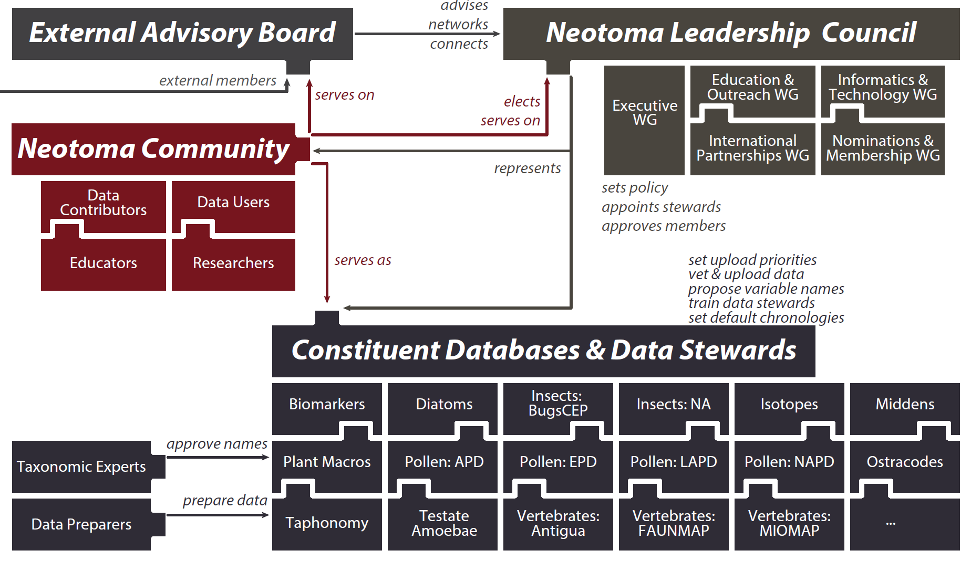
Distributed & Open Scientific Governance
Williams, Grimm et al. in press, Quaternary Research
Figure design: Rob Roth
Join as Member: https://tinyurl.com/NeotomaMember
Contribute Data: https://www.neotomadb.org/data/category/contribution

Slide 32






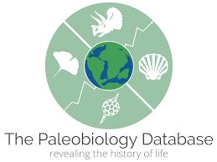


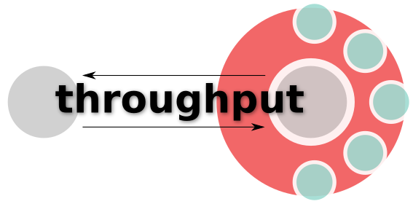

Partners
Recommended by
Partners With
GeoDeepDive

Slide 33


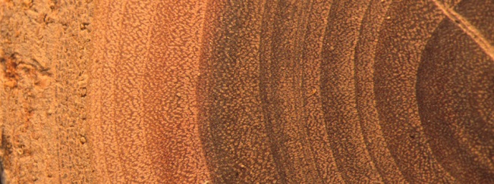


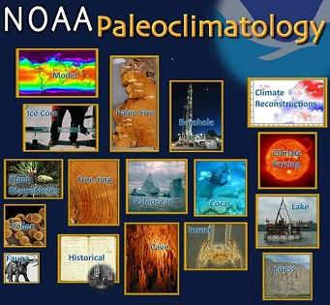
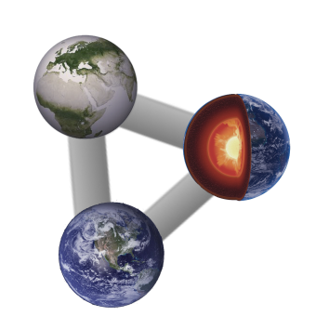







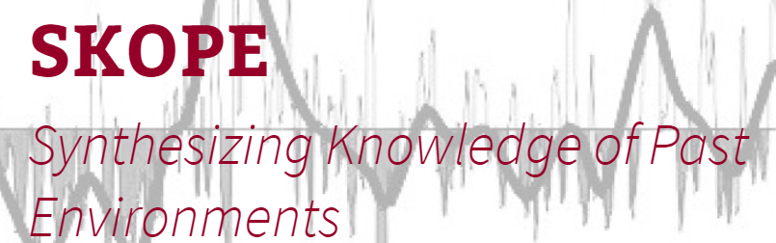
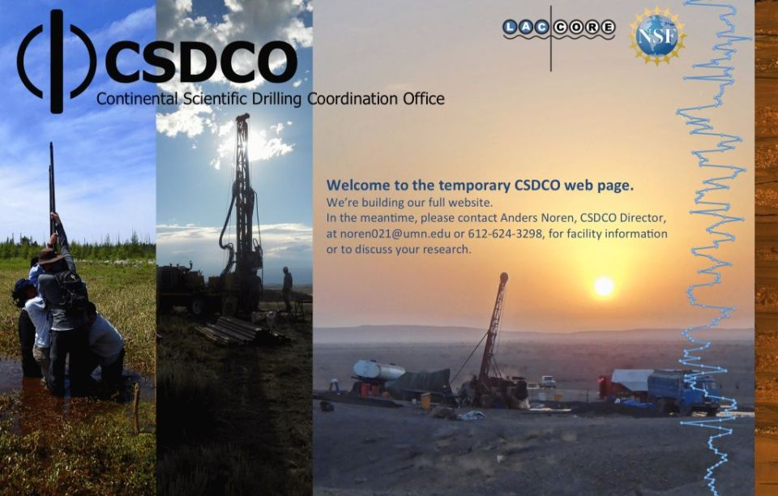




Next Level: Growing, Sustaining, and Connecting a Network of Networks
Biodiversity & Trait DBs
Climate &
Paleoclimate
Paleoecology
WaterIsotopes
Neotoma DB
ITRDB
Linked Earth
Ecology
Archaeology
Paleobiology DB
PEcAn
Sample & Core Curators
Geochronology
geochronAPI

Slide 34
Thanks!
NSF-Geoinformatics,
EarthCube, DEB,
Macrosystems
PalEON PIs, Postdocs: Jason McLachlan, Andria Dawson, Michael Dietze, Andrew Finley, Simon Goring, Amy Hessl, Phil Higuera, Mevin Hooten, Yao Liu, Jenn Marlon, Jackie Matthes, Dave Moore, Chris Paciorek, Neil Pederson, Jody Peters, Steve Jackson, Christy Rollinson, Jack Williams, Jun Zhu
Neotoma DB
Neotoma PIs & Developers: Eric C. Grimm, Jack Williams, Jessica Blois, Simon Goring, Alison Smith, Joaquin Arroyo-Cabrales, Allan Ashworth, Julio Betancourt, Bob Booth, Phil Buckland, Don Charles, Steve Crawford, Brandon Curry, Ed Davis, Thomas Giesecke, Russ Graham, Steve Jackson, Rob Roth, Mike Stryker, et al.

Slide 36
EXTRA SLIDES

Slide 37
Why we need paleohistorical data to improve ecological forecasting
Contemporary Systems in Flux: We’re now in midst of ‘Great Acceleration’, rapid rates of change
Key Processes are Slow: Ecosystem models’ parameterization and representation of decadal- to centennial-scale processes are poorly constrained
A Deeper Baseline: Study the transient and non-stationary trajectory of ecosystems starting ~2000 years ago and continuing through the 21st century
However: paleoecological data are not in a format suitable for integration with TEMs - requires statistical modeling

Slide 38
PalEON SetVeg Workplan & Current Work
Build settlement-era (~1800AD) datasets of forest composition from Public Land Survey (PLS) & Township Proprietor Survey (TPS) data
Assemble settlement-era pollen records
Calibrate STEPPS pollen-vegetation model
Apply STEPPS to reconstruct vegetation for last 2000 years
Test CMIP5 settlement-era vegetation simulations
Assimilate terrestrial ecosystem model simulations with data-based estimates
DONE
UNDERWAY
Notes:
Note all the data in Minnesota – give a shoutout to Herb and Margaret here.

Slide 39
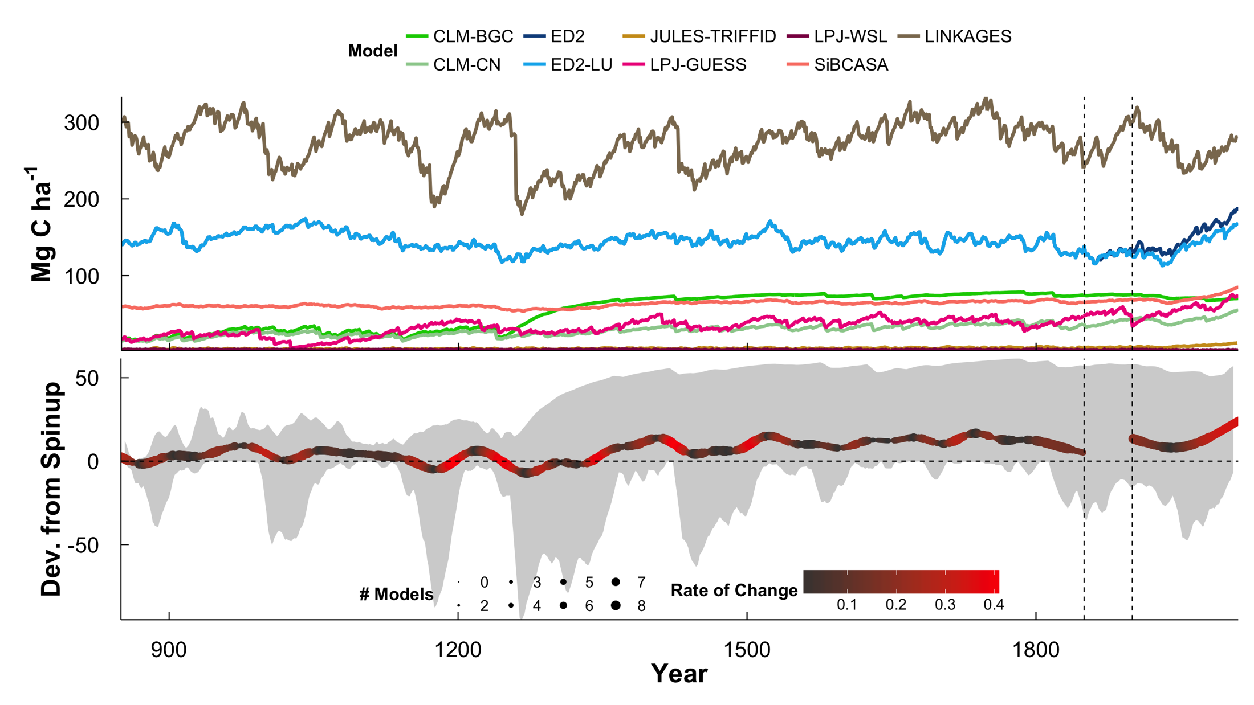
Last-millennium simulations now done, data-model comparisons, assimilation beginning
Aboveground Biomass
C. Rollinson et al. in prep.

Slide 40
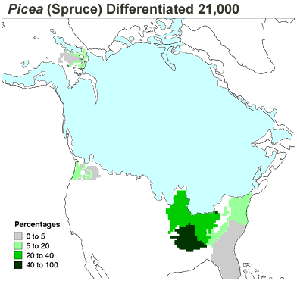
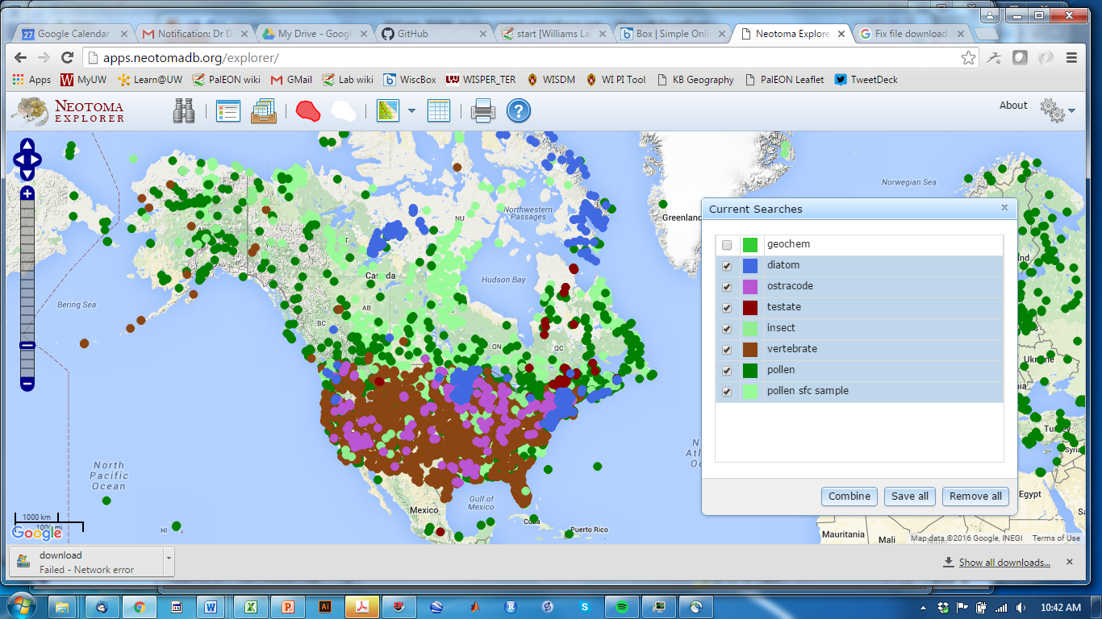
Neotoma Paleoecology Database
Mission: Enable study of species dynamics during past environmental change
Spatiotemporal Database: Species occurrences & abundances in space and time
Spatiotemporal Domain: Global, Recent to ~Miocene
Centralized IT, Distributed Governance. Composed of virtual constituent databases organized by taxon group and region
Open data accessible in several ways
Broad user community: Paleoecologists, ecosystem modellers, paleoclimatologists, biogeographers, educators, …
Neotoma DB
www.neotomadb.org
Williams, Grimm et al. in review Quaternary Research

Slide 41

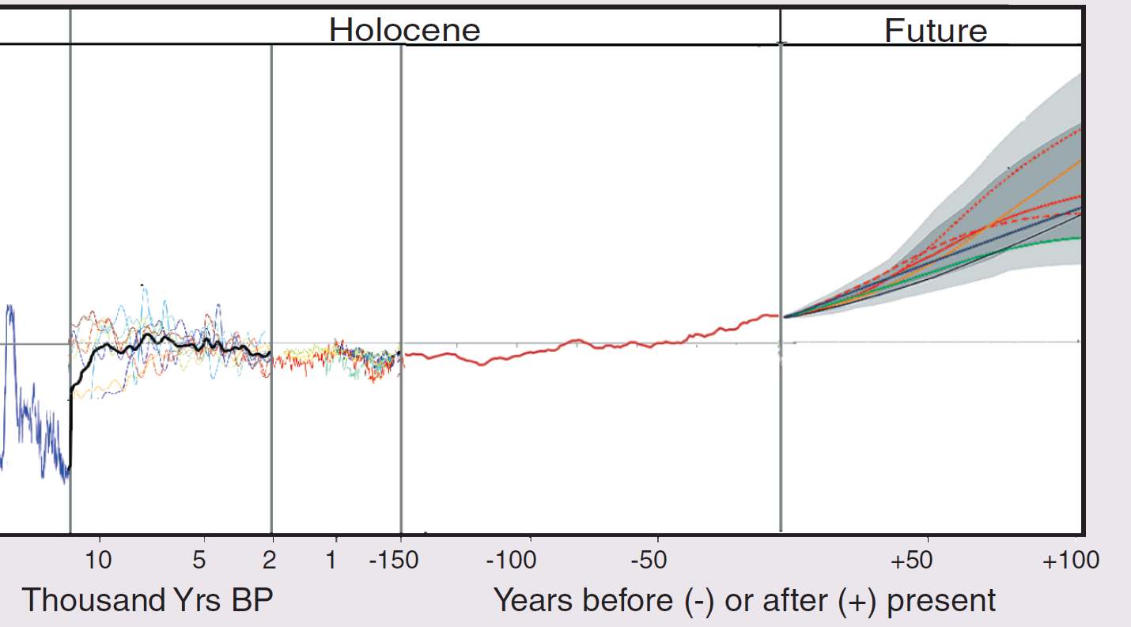
Statement of Problem
We live in a rapidly changing world.
We seek to document ecological changes, understand the underlying processes, and build better forecasting models.
Our data often are dispersed, collected by many investigators at many localities, representing many variables.
We must assemble site-level records into larger open and high-quality data networks
Moritz & Agudo 2013 Science
Neotoma DB
Notes:
We must assemble – many good reasons – cross-scale processes,

Slide 42
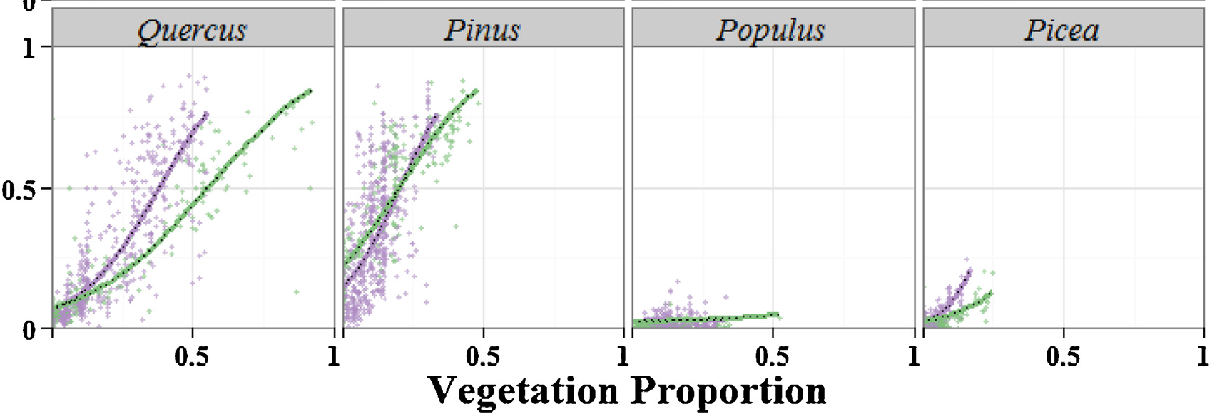
Pollen-vegetation relationships have also changed over same time period
Pollen Proportion
Vegetation Proportion
Based on GLM models (R: gamlss), zero-inflated beta distrib.
Green: settlement-era pollen-vegetation models
Purple: early 21st-century pollen-vegetation models
Goring & Williams 2016, Ecology Letters

Slide 43
Conclusions
Networks essential in global-change ecology
Paleodata well suited for networks
Community-curated data resources (CCDRs) enable gathering of site-level data into high-quality, value added data resources
CCDRs increasingly are foundational infrastructure for big data science.
PalEON offers one example of how CCDRs can be leveraged into studying large-scale ecological processes, improving ecological forecast models

Slide 44
Paleoecological Data Networks
Collected by many workers, using many methods. Need to be gathered together into networks
A challenge of informatics
Paleoecological data produced by multiple environmental and ecological signals. Ecological forecasting models require tight-data model loops and well-characterized data, uncertainty.
A challenge of statistics and process-based modeling
Neotoma DB

Slide 45
Paleoecological Data Networks
‘Long Tail’: Collected in the field & lab by many individuals and scientific teams.
Heterogeneity: Many kinds of measurements & methods
Distributed Scientific Expertise by proxy type, archive type, region, time period, and/or taxonomic group
Commonality: All involve measurements of proxies in various geological archives by depth, from which we estimate time.
Community: Well defined community of practice (paleoecologists)
Long Shelf Life: specimens & samples collected decades ago are can be re-analyzed
Bad News
Good News

Slide 46
Neotoma Data is Open, Many Ways to Access
Neotoma Explorer
https://apps.neotomadb.org/Explorer/
Neotoma APIs
https://api.neotomadb.org/
Neotoma R
https://cran.r-project.org/web/packages/neotoma/index.html
https://github.com/ropensci/neotoma
DOIs & Landing Pages
https://data.neotomadb.org/datasets/1001/
Workshop & Training Materials
https://github.com/NeotomaDB/Workshops

Slide 47
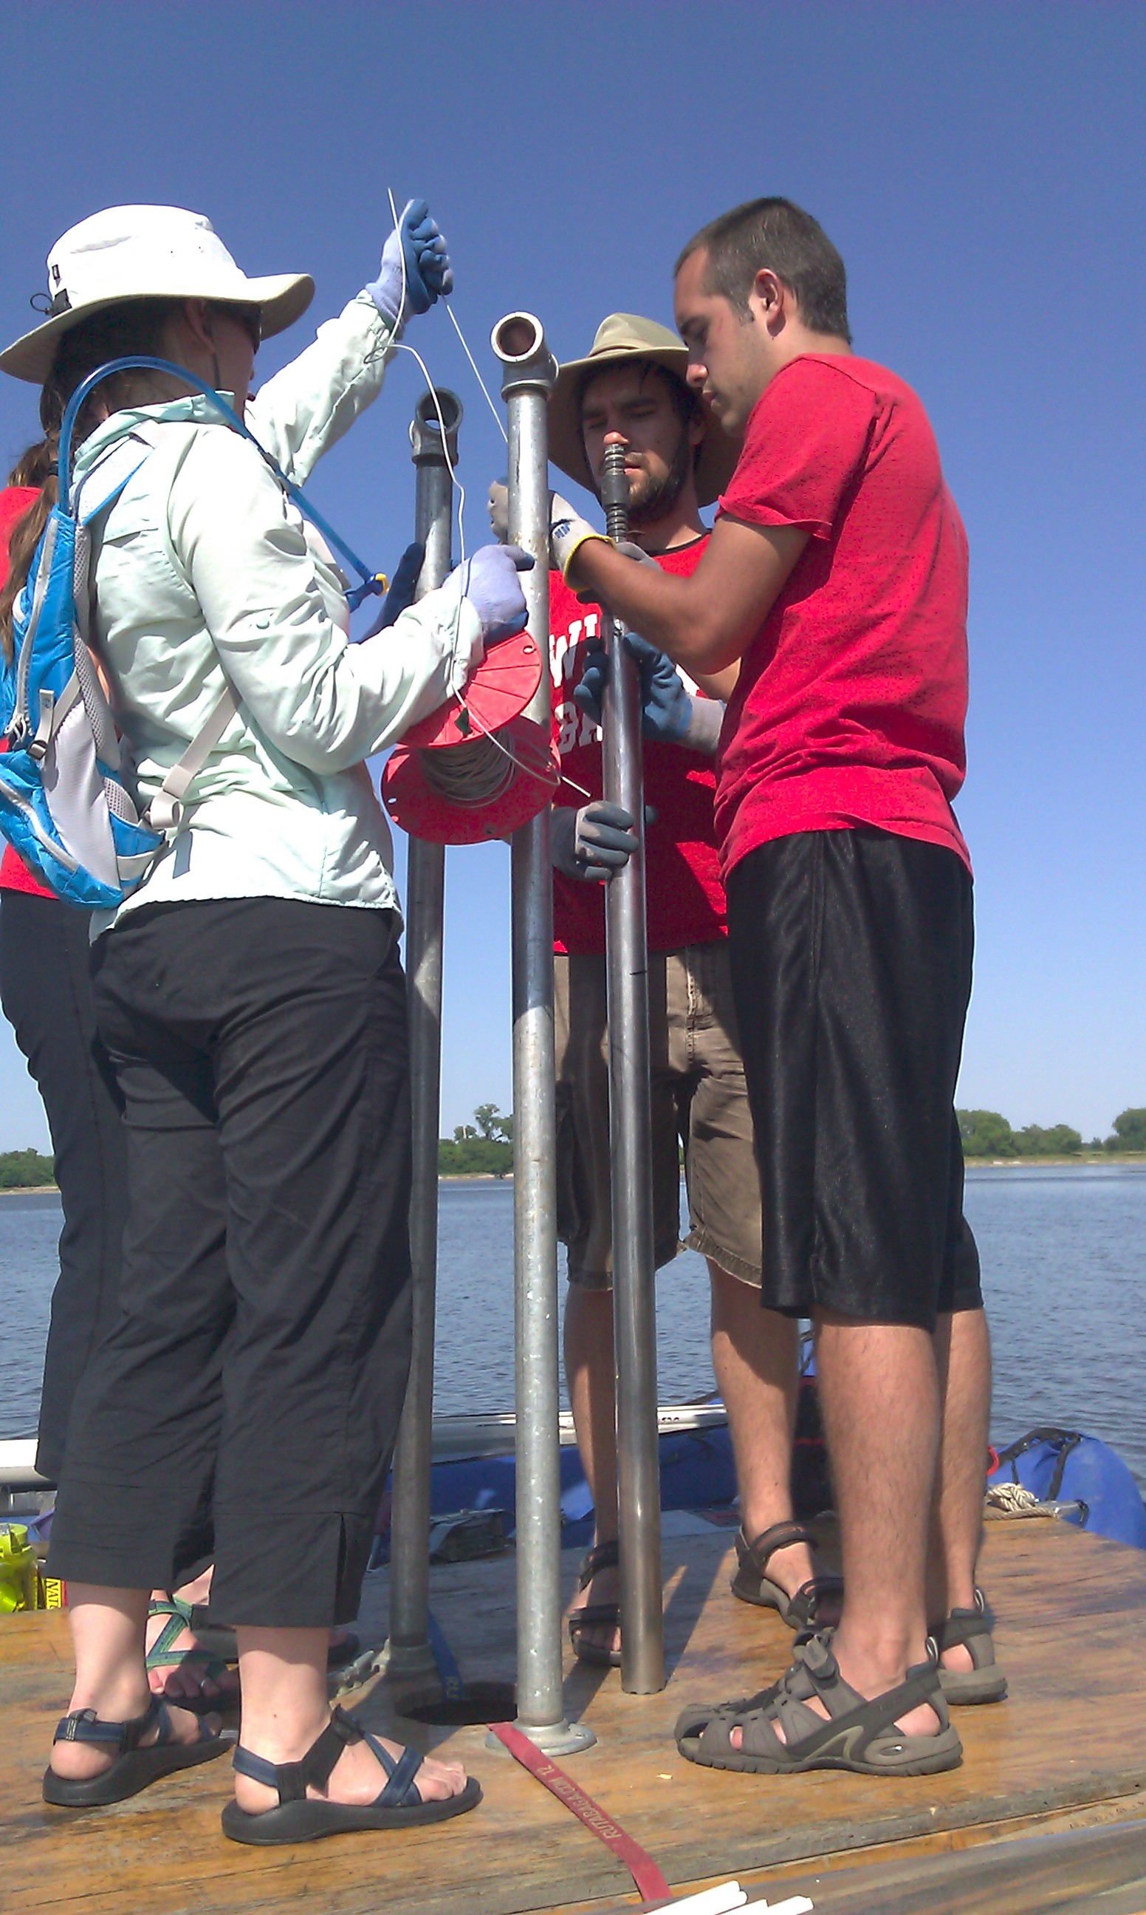
Paleoecological Data Networks

Slide 48
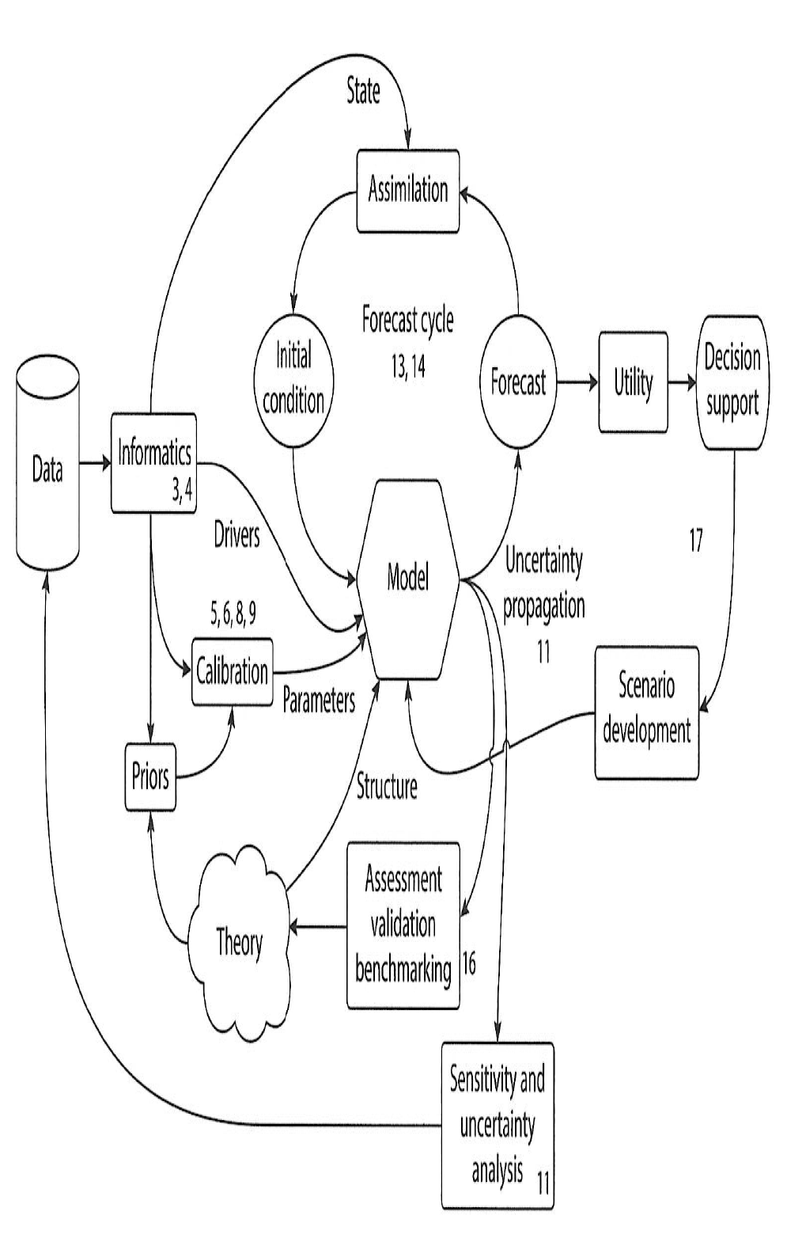
Ecological Forecasting and Model-Data Integration
Dietze 2017 Ecological Forecasting, Princeton U Press
Notes:
Requires easy access to well-described data (INFORMATICS)
Iterative. Data is used and reused.

Slide 49
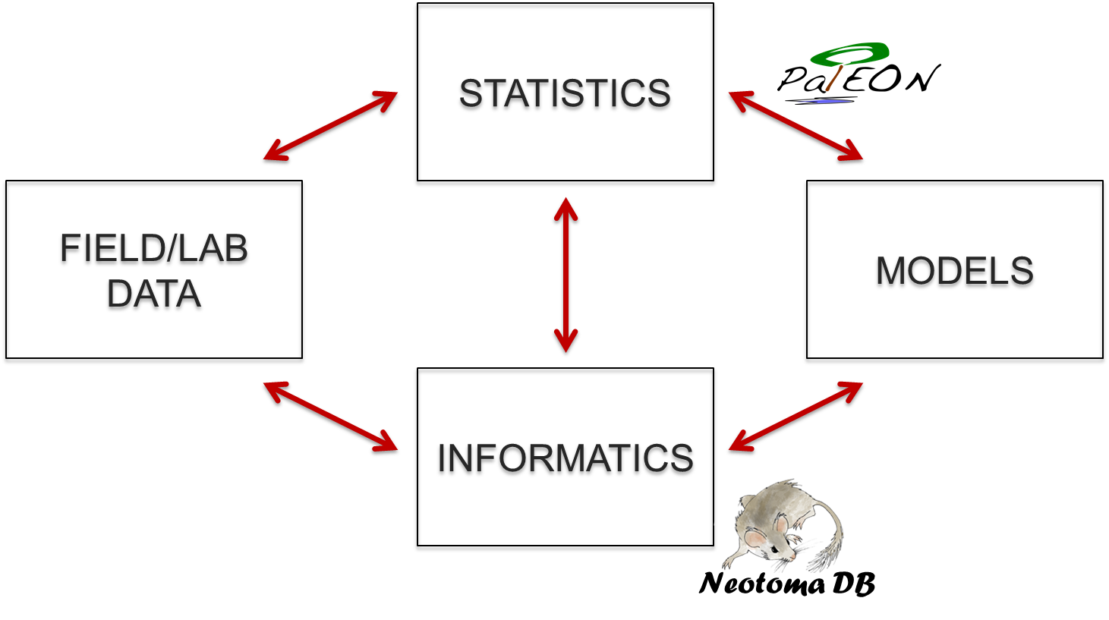
Ecological Forecasting and the Model-Data Forecast Cycle
Dietze 2017 Ecological Forecasting, Princeton U Press
Notes:
Requires easy access to well-described data (INFORMATICS)
Iterative. Data is used and reused.

Slide 50
Paleodata: Key characteristics
‘Long Tail’: Collected in the field & lab by many individuals and scientific teams.
Heterogeneity: Many kinds of measurements & methods
Distributed Scientific Expertise by proxy type, archive type, region, time period, and/or taxonomic group
Commonality: All involve measurements of proxies in various geological archives by depth, from which we estimate time.
Long Shelf Life: specimens & samples collected decades ago are can be re-analyzed
Bad News
Good News

Slide 51
Challenge: Long Tail Data
‘Long Tail’: Collected in the field & lab by many individuals and scientific teams.
Heterogeneity: Many kinds of measurements & methods
Distributed Scientific Expertise e.g. by taxonomic group, ecological system, region, time period
Commonality: All involve measurements of proxies in various geological archives by depth, from which we estimate time.
Long Shelf Life: specimens & samples collected decades ago are can be re-analyzed
Bad News
Good News

Slide 52
Paleodata: Key characteristics
‘Long Tail’: Collected in the field & lab by many individuals and scientific teams.
Heterogeneity: Many kinds of measurements & methods
Distributed Scientific Expertise by proxy type, archive type, region, time period, and/or taxonomic group
Commonality: All involve measurements of proxies in various geological archives by depth, from which we estimate time.
Long Shelf Life: specimens & samples collected decades ago are can be re-analyzed
Bad News
Good News

Slide 53
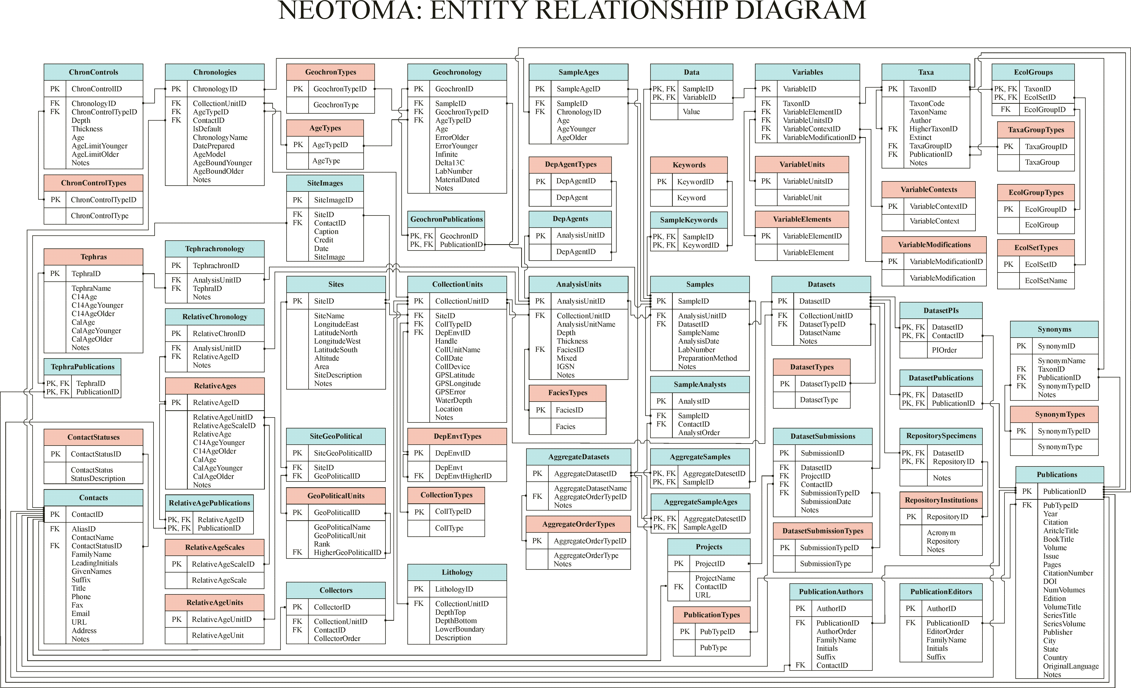
Neotoma as Boundary Organization
Paleoecologists
Data Users
Pollen
Paleoecol-ogists
Neotoma DB
Vertebrates
Data
Data
Paleoclimat-ologists
Insects
New Questions
Ecosystem Modelers
Best Practices
Shared Protocols
Diatoms
Biogeograph-ers
Ostracodes
Amoebae
Informatics & Computer Scientists
IEDA
GeoWS
Open Core
Packrat Middens

Slide 54
My Research Goal (broad):
Describe the patterns of species distributions, community composition, and their changes through time…
Understand the governing environmental, biological, and anthropogenic processes…
At global to local scales…
At timescales of 10⁵ to 10¹ years.
Notes:
I’m a big believer in working from pattern to process. I recognize this is really broad and arm-wavy. It’s ambitious. It’s pretty general.
To make it more concrete…

Slide 55





Q: Whence Neotoma?
A: Named for the packrat (Neotoma), a multiproxy data collector.

Slide 56

Moving up the Value Chain: Generic Depositories to Community-Led Repositories
BIG DATA
Community-
Led Repositories
interoperable
harmonized, community governance & input
re-usable
Generic Depositories
context,
provenance
accessible
authorization,
protocols
Neotoma
NOAA-Paleo
LinkedEarth
findable
identification,
persistence
Data Dryad
FigShare
Journal Data Supplements
small data
Modified from K. Lehnert
Notes:
Note that right now, most of us could meet NSF Data Management Plans by submitting our data to Data Dryad. They’ll archive it and give it a DOI. But is this actually useful? I’d argue that this is meeting the letter of the law but not the spirit.
We need CCDRs to enforce metadata standards. WE should think of them like journals. Just like we only use peer-reviewed papers, we should only use community-curated data.
Could say a few words about NOAA-Paleo. They made a good decision 20 years ago to set a very low bar to metadata standards and needs. Key challenge then was to encourage people to submit data.
But now times have changed and now we need higher bars.

Slide 57
Neotoma Paleoecology DB: A Community-Curated Data Repository (CCDR) for paleoecological data
Key Characteristics
Open Data
Curated by Community -> High-Value Data
Standardized Variable Names & Taxonomy
Flexible data models for sites, proxies, cores, etc.
Time: Age Controls and Age Models
Neotoma DB
www.neotomadb.org
Grimm (AmQua 2016): NEOTOMA Paleoecology Database: Community-led cyberinfrastructure for global change research
Williams et al. (in review, GSA Today): Building big data from the long tail: Community-Curated Data Resources in the paleogeosciences
Notes:
Point to Eric here – he’ll talk more about Neotoma. I’m going to stay more general and talk about CCDRs.

Slide 58
Purposes of Neotoma
Facilitate studies of ecosystem development and response to climate change
Enable joint analysis of multiproxy datasets to address paleoenvironmental questions that transcend those possible with single-proxy databases.
Provide the historical context for understanding biodiversity dynamics, including genetic diversity
Provide data for climate-model validation
Facilitate analyses of biostratigraphy
Provide a safe, long-term, low-cost archive for a wide variety of paleobiological data
Lower the overall cost of paleodata management
Meet data management, data sharing, and archival requirements of funding agencies, institutions, and journals.

Slide 59
Neotoma Paleoecology Database Key Features
Spatiotemporal database: species occurrences & abundances in space and time
Age controls and age models stored
Centralized IT and Distributed Scientific Governance. Neotoma composed of several constituent databases (e.g. North American Pollen Database, FAUNMAP)
Open data accessible via Explorer, APIs, R Neotoma
Broad user community: Paleoecologists, ecosystem modellers, paleoclimatologists, biogeographers, educators, …
Neotoma DB
www.neotomadb.org

Slide 60


Neotoma Paleoecology Database: Design Concepts
Spatiotemporal database: species occurrences & abundances in space and time
Age controls and age models stored
Centralized IT and Distributed Scientific Governance. Neotoma composed of several constituent databases (e.g. North American Pollen Database, FAUNMAP)
Open data accessible via Explorer, APIs, R Neotoma
Broad user community: Paleoecologists, ecosystem modellers, paleoclimatologists, biogeographers, educators, …
Neotoma DB
www.neotomadb.org

Slide 61

How do we best leverage our site-level data into global-scale science?
Sensor networks
Satellites
High-throughput gene sequencers
Earth System Models
“Big Data”
Challenges:
*Many Collectors
*Data Heterogeneity
*Data Friction
*Curation & Retrieval
Challenges:
*Storage & processing
*Data integration
*Data deluge
Data Size
Species surveys
Field experiments
Paleo proxies
Biogeochemical Data
“Long Tail”
Datasets
C4P
Williams et al. (in review) GSA Today
Notes:
A lot of ecological data is in the latter category…

Slide 62




Facilitating Data Sharing & Exchange
1
1. Neotoma data now searchable through NOAA-Paleo
2. Neotoma & Paleobiology DB -> EarthLife Consortium
3. Cyberinfrastructure for Paleogeoscience (C4P) RCN
Resource catalogs for paleogeoscience data resources (link) and software (link).
Webinars describing current efforts in the paleogeosciences (link)
Paleodata Hackathon!
Recommended next steps (EOS ms.)
2
earthlifeconsortium.org
Paleodata Hackathon June, 2016
3

Slide 63
Data Mobilization Campaigns Underway
Mobilization Campaigns
Pollen: NAPD, EPD, et al.
Vertebrates: FAUNMAP2+, MIOMAP, ANTIGUA, MQMD
Ostracodes: NANODe
Diatoms: Drexel DB
Testate Amoebae
Packrat Middens
Organic Biomarkers

Slide 64





Paleoecology & paleoclimatology: A strong tradition of data sharing & global-scale synthetic research
These global-scale syntheses are increasingly limited by ‘data bottlenecks’
Lots of reinventing the wheel, duplication of effort
COHMAP, 1988, Science
CLIMAP
COHMAP
PAGES2K
BIOME6000
PMIP
LANDCOVER6K
…
Patrick
Bartlein
Eric Grimm
Tom Webb
Sandy
Harrison
Notes:
Shoutout to Eric Grimm and

Slide 65
Reconstructing Vegetation for last 2 ka: Neotoma – PalEON integrated workflow
Data cleaning,
standardization,
upload
Individual Data Contributors
Hotchkiss, Calcote, & Lynch
Hupy & Yansa
Booth & Jackson
Cushing
St. Jacques
Neotoma DB
R
neotoma
Rebuild age
models (bacon)
STEPPS
Pollen
Paleoveg.
Witness Tree
Data
Reconstrux
w/ uncertainty
Vegetation
Goring et al. (2015) Open Quaternary
Goring et al. (2016) PLoS
Dawson et al. (2016) QSR, Dawson et al. in prep.

